Slide 1
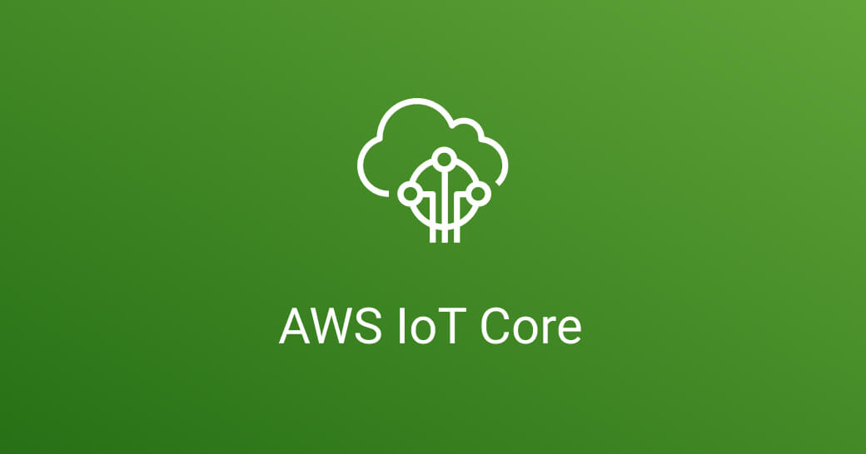

Slide 2
What are iot devices ?
IoT devices are pieces of hardware, such as sensors, actuators, gadgets, appliances, or machines, that are programmed for certain applications and can transmit data over the internet or other networks.
IoT devices are using AI and machine learning to bring intelligence and autonomy to systems and processes, such as autonomous driving, industrial smart manufacturing, medical equipment, and home automation.

Slide 3
What is aws Iot core?
It is a managed cloud service that lets connected devices easily and securely interact with cloud applications and other devices.
It can support billions of devices and trillions of messages, and can process and route those messages to AWS endpoints and to other devices reliably and securely.

Slide 4
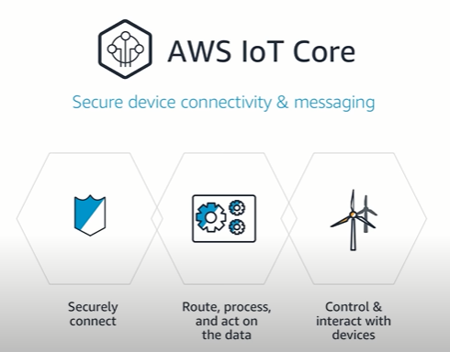
Why aws iot core?

Slide 5
Project : Temperature and humidity with AWS iot core

Slide 6
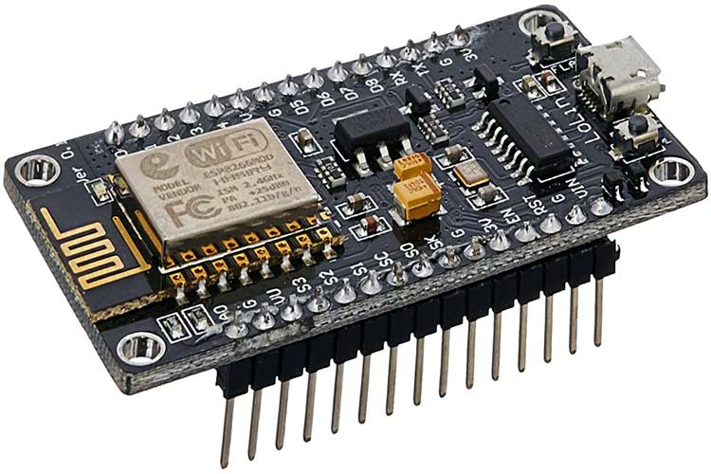
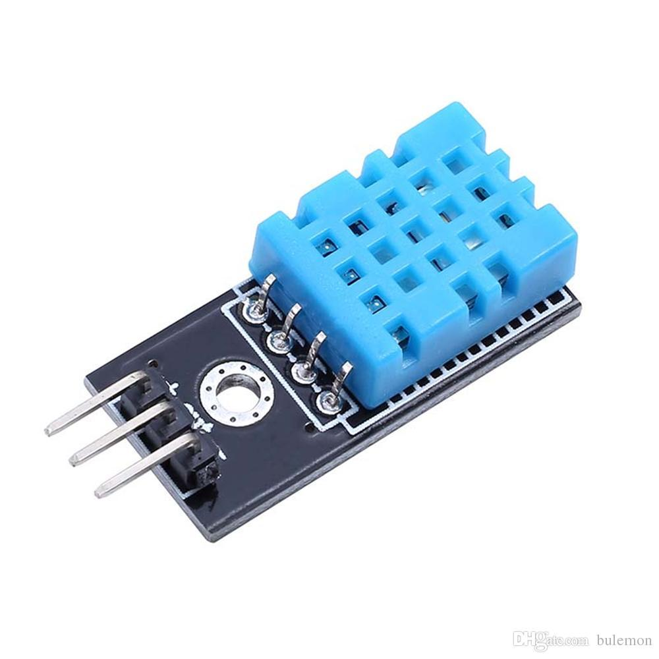
Components :
ESP2866
DTH sensor

Slide 7

Connection with AWS iot core :
Signing in :
Go to your web browser and search visit following link: aws.amazon.com/iot-core/.

Slide 8
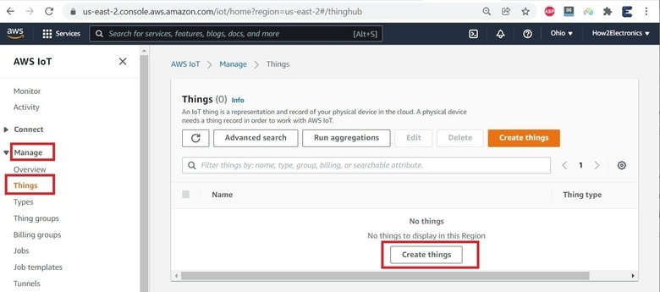
Create a thing :

Slide 9
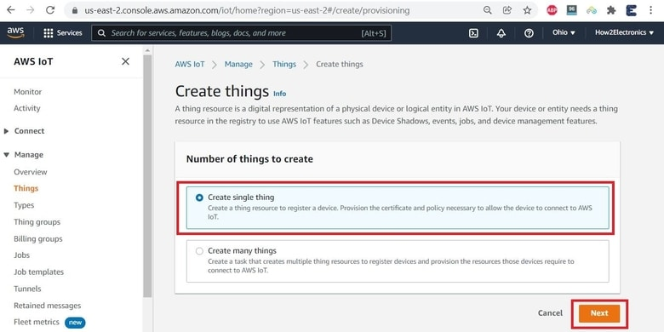

Slide 10
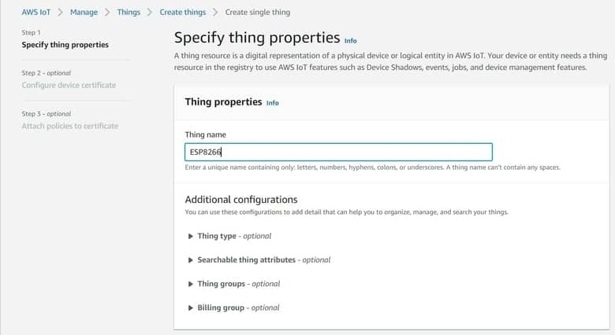

Slide 11


Slide 12
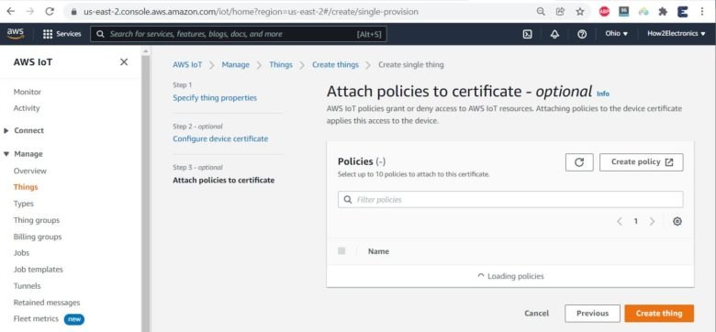

Slide 13



Slide 14


Slide 15


Slide 16
Physical Demo !

Slide 17

Thanks for listening!

